Slide 1

An investigation into Psychological Predictors of Trypophobia Severity

Slide 2
Background of trypophobia
Trypophobia is defined as the fear of holes – sufferers report feelings of aversion and disgust towards clusters towards patterns of holes or dots, such as those on a honeycomb, lotus pod or sponge.
This is not classified as a disorder or phobia in the DSM-5, regardless of the detrimental effects it can have on one’s life.
A case study of a 12 year old female presented feelings of extreme fear and discomfort towards deeded bread, polka dot patterned clothing and perforated concrete walls, which increased heart and breathing rate as well as feelings of nausea.

Slide 3
The behavioural immune system
This system responds to disease cues in the environment and produced feelings of disgust, which indicates an avoidance behaviour should occur.
There are certain disease cues that display clusters of approximately circular shapes, such as maggots on rotten meat or the appearance of clusters related to skin diseases e.g. leprosy and smallpox.
Trypophobia can be thought of as an overgeneralised response of the behavioural immune system towards disease-irrelevant cluster stimuli with shared characteristics as the disease cues previously described.
This theory has initiated investigation of the relationship between disgust sensitivity towards the spread of disease and trypophobia.

Slide 4
Previous literature
Imaizumi et al. (2016)
Used the Trypophobia Questionnaire (TQ) to assess trypophobia severity, and the disgust-scale revised (DS-R) and found that core disgust scores significantly predicted trypophobia severity.
Kupfer and Le. (2017)
- Found a correlation between pathogen disgust sensitivity from the Three Domain Disgust Scale (TDDS) and trypophobia severity, but not the moral or sexual domains.

Slide 5
This current study
Investigating the disease-avoidance framework further, the perceived vulnerability to disease scale (PVD) was used as a disease-avoidance measure, which has a ‘germ aversion’ and ‘perceived infectability’ subscale, against the TQ. I hypothesised that the germ aversion subscale would significantly predict trypophobia severity.
The PVD has been utilised in only one prior trypophobia study, which found no relationship between the PVD and TQ (Pipitone et al., 2022).
No relationship regardless of the correlation between the germ aversion subscale and disgust sensitivity subscales; contamination and interpersonal disgust.
The findings from this project also found no relationship between the PVD and TQ.

Slide 6
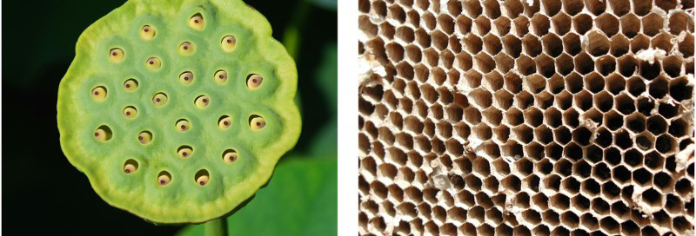
TQ trypophobic stimuli
(Le et al., 2015)

Slide 7
Discussion points
The PVD may be measuring a more general fear of infection as it uses statement such as “it really bothers me when people sneeze without covering their mouths”, which is not directly related to the disgust elicited by the transmission of infection.
Trypophobic individuals have previously reported more feelings of disgust over fear (Vlok-Barnard & Stein, 2017), hence the PVD more closely measured feelings of fear which are less associated with trypophobia.
Trypophobia has been previously associated with pathogen and core disgust which reflect the disgust towards transmission of infectious disease through objects, whereas the germ aversion subscale has had a stronger correlation with contamination and interpersonal disgust, reflecting disease spread by people.

Slide 8
Additional findings
BFI-2 neuroticism scale was used to measure this personality trait which is found amongst individuals with a specific phobia, and has previously positively correlated with trypohobia severity (Mayor et al., 2021)
This current study also found that neuroticism scores significantly predicted trypophobia severity.
This highlights a similarity between trypophobia and specific phobias, raising questions regarding whether trypophobia could be classified as a specific phobia in the future.

Slide 9
Single-item perceived trypophobia severity
Due to high attrition rates from prior trypophobia studies, a slider scale from 0 to 100 measuring self-reported perceived severity was taken without the requirement of observing trypophobic stimuli.
Similar results were found using this item as the outcome variable in a second regression, hence a correlation test between TQ scores and single item scores was conducted.
Moderate to strong correlation between TQ and single item scores suggests that trypophobia severity could be assessed in future studied without the requirement of looking at trypophobic stimuli, which could cause attrition from the studies.

Slide 10
References
Mayor, E., Meyer, A., Miani, A., & Lieb, R. (2021). An exploration of the nomological network of trypophobia. PLoS ONE, 16(9), 1–15. https://doi.org/10.1371/journal.pone.0257409
Imaizumi, S., Furuno, M., Hibino, H., & Koyama, S. (2016). Trypophobia is predicted by disgust sensitivity, empathic traits, and visual discomfort. SpringerPlus, 5(1449), 1–5. https://doi.org/10.1186/s40064-016-3149-6
Kupfer, T. R., & Le, A. T. D. (2018). Disgusting clusters: Trypophobia as an overgeneralised disease avoidance response. Cognition and Emotion, 32(4), 729–741. https://doi.org/10.1080/02699931.2017.1345721
Le, A. T. D., Cole, G. G., & Wilkins, A. J. (2015). Assessment of trypophobia and an analysis of its visual precipitation. The Quarterly Journal of Experimental Psychology, 68(11), 2304–2322. https://doi.org/10.1080/17470218.2015.1013970
R. Nathan Pipitone, Christopher DiMattina, Emily Renae Martin, Irena Pavela Banai, KaLynn Bellmore & Michelle De Angelis (2022) Evaluating the ‘skin disease-avoidance’ and ‘dangerous animal’ frameworks for understanding trypophobia, Cognition and Emotion, 36:5, 943-956, DOI: 10.1080/02699931.2022.2071236

